Slide 1
NAME: PRAMOD CHANDRA P
SkillsBuild Email ID:pramodchandrasince2004@gmail.com
College Name: Panimalar Engineering college
College State: Tamil Nadu
Internship Domain: Artificial Intelligence
Internship Start :12/06/2023
Internship End Data:24/07/2023

Slide 2


MENTAL HEALTH FITNESS TRACKER

Slide 3





PROJECT TOPIC
To develop a mental health fitness tracker using Artificial Intelligence that monitors and promotes well-being by tracking various aspects of mental health.

Slide 4
AGENDA
This presentation centers around the development of a cutting-edge mental health fitness tracker, designed to enhance overall well-being. The key focus areas include an in-depth discussion of crucial features and functionalities, meticulous project planning, dataset selection, data preprocessing techniques, data visualization strategies, technical implementation details, target user demographics, model training and testing approaches, and the achieved accuracy levels.

Slide 5
Project Overview
This project aims to develop a user-friendly mobile or web application, the Mental Health Fitness Tracker, to empower individuals in actively monitoring and improving their mental well-being. By incorporating features that allow tracking of mood, stress levels, physical activity, sleep patterns, and more, this innovative tool will provide users with valuable insights and personalized recommendations. The project encompasses the technical implementation of a comprehensive mental health tracking system, with the goal of fostering a proactive approach towards mental well-being

Slide 6
WHO ARE THE END USERS?
The end users of the Mental Health Fitness Tracker can include individuals who are seeking to monitor and improve their mental well-being. This can encompass a wide range of users, General Users, individuals with Mental Health Concerns, Fitness Enthusiasts, Corporate Wellness Programs, Mental Health Professionals. The Mental Health Fitness Tracker is designed to be accessible and beneficial for a wide range of end users, whether they are looking to proactively improve their mental well-being or are seeking additional support for managing mental health concerns.

Slide 7
SOLUTION AND PRESENTATION
The proposed solution is to develop a Mental Health Fitness Tracker, a user-friendly mobile or web application that combines physical and mental health tracking features to promote overall well-being. The tracker will empower users to take charge of their mental well-being and make informed decisions for their mental health journey.

Slide 8
Algorithm
In this model we use Support Vector Regression(SVR)
Support Vector Regression (SVR) is a machine learning algorithm that is used for regression tasks. It is a variant of Support Vector Machines (SVM) and shares some similarities in its underlying principles. SVR is particularly useful for modeling and predicting continuous numerical values. SVR is a versatile regression algorithm that can capture nonlinear relationships between features and target variables. It is commonly used in various domains, including finance, economics, and engineering, where accurate numerical predictions are essential

Slide 9
MODELING
The first step is to import the package that we are going to use.
The next step is to read the dataset and data preprocessing.
Further we visualize the data by using various visualization techniques.
Make the datasets to train and we make the dataset to fit into the model.
Using the algorithm the model will predict the output.
Test the model whether it prediction is correct or not.

Slide 10
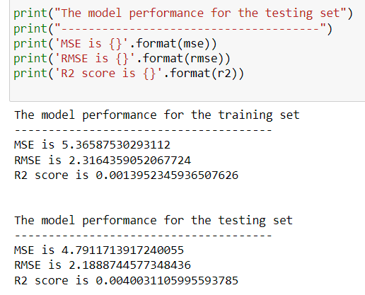

RESULTS
The accuracy of our model showed in the picture for both training and testing.
The result will consist of
Mean Square Error (MSE).Mathematically,
MSE = (1/n) * Σ(yi - ŷi)².
Root Mean Squared Error (RMSE) . Mathematically, RMSE = √(MSE)
The R-squared score(R2 score), also known as the coefficient of determination.
R-squared = 1 - (SSR/SST).

Slide 11
LINK
The model image will be available in the given link below
https://drive.google.com/drive/folders/1MY88wWUFYcB91jLULhGO-iyoRiOf6UcR?usp=sharing

Slide 12

Thank You!

